Slide 1
Printers
Unit objectives
Identify features of dot-matrix printers
Install, use, and troubleshoot inkjet printers
Install, use, and troubleshoot laser printers
Identify other printer types

Slide 2
Dot-matrix printer
Dot-Matrix printer been around since PCs.
Impact printer—Multipart forms
Use mechanical means to press ink from ribbon onto page.
Type writer print quality
Near Letter Quality (NQL)
9 or 24 pin print head
9pins == low quality and 24 pin has smaller pins close to each other giving better quality print.
Various size and shape ribbon cartridges
Tractor feed and friction feed
Uses a sprocket to mesh with holes in the side of continuous form paper. Type writers use friction feed.
Serial or parallel connections

Slide 3
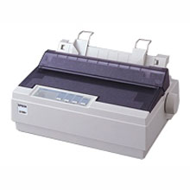
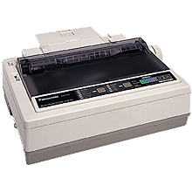
Examples of Dot Printers

Slide 4
Other impact printers
Daisy wheel Printers
Band printer
www.techweb.com/encyclopedia/defineterm.jhtml?term=band+printer

Slide 5
Dot-matrix printer issues
Print head -Print heads wear off after a while.
-The ink from the ribbon can clog the tiny pins that make up the tiny pins
-Pins can be bent
-Electromagnet can be damaged
Ribbon- Poor print quality can simply mean that the ribbon needs to be replaced. Each printer get its own ribbon, the cartridge that the ribbon contained within varies from printer to printer thus they are not interchangeable.
Overheating- Due to noisiness dot matrix printers are often kept under a padded, sound proofed cover.
-Less ventilation lead to overheating
Paper jams- Biggest problem paper jam
- If perforated sides can be ripped off they jam the printer. (patience ,patience , patience is required to fix that .)

Slide 6
Dot-matrix printer issues
Other problems
  Printer drivers
  Error messages
  Memory
  Configuration
  Connections
  Print quality

Slide 7
Options and upgrades
Paper park
Input and output trays
Font cartridge slots
Paper cutters

Slide 8
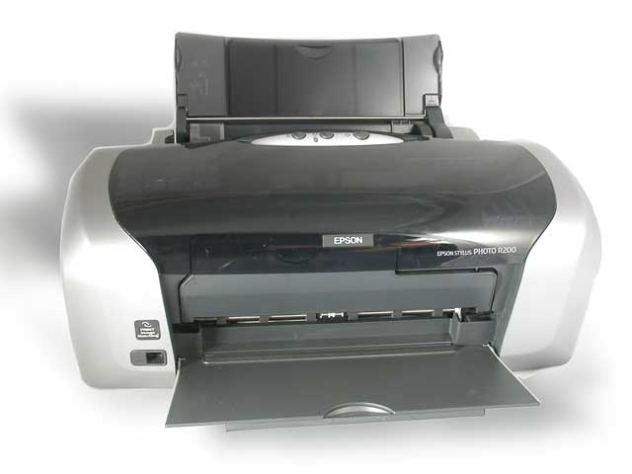
An inkjet printer

Slide 9
Inkjet process
Ink jet printers or Ink dispersion printers
Forcing ink through tiny holes. 50-60 microns diameter.
Two methods: Thermal Bubble or Piezoelectric Tech.
Thermal bubble technology- Heats the ink, which vaporizes it creating a bubble. The bubble protrudes out through the nozzle, and sprays onto paper. When the bubble bursts it creates a vacuum which draws more ink from the cartridge into the print head, readying it to create another dot.
Piezoelectric technology- Creates a bubble with a piezo crystal behind each nozzle. An electrical current sent to the crystal causes it to vibrate. When it vibrates inward, it releases ink onto the paper; when it vibrates outward it pulls ink from the cartridge.
Ink cartridges– Ink reservoirs. The number varies from printer to printer.
Dithering– Shades of each of basic color.
Dithering is the process of juxtaposing pixels of two colors to create the illusion that a third color is present. A simple example is an image with only black and white in the color palette. By combining black and white pixels in complex patterns a graphics program like Adobe Photoshop can create the illusion of gray values
Print heads– Wears off fastest

Slide 10
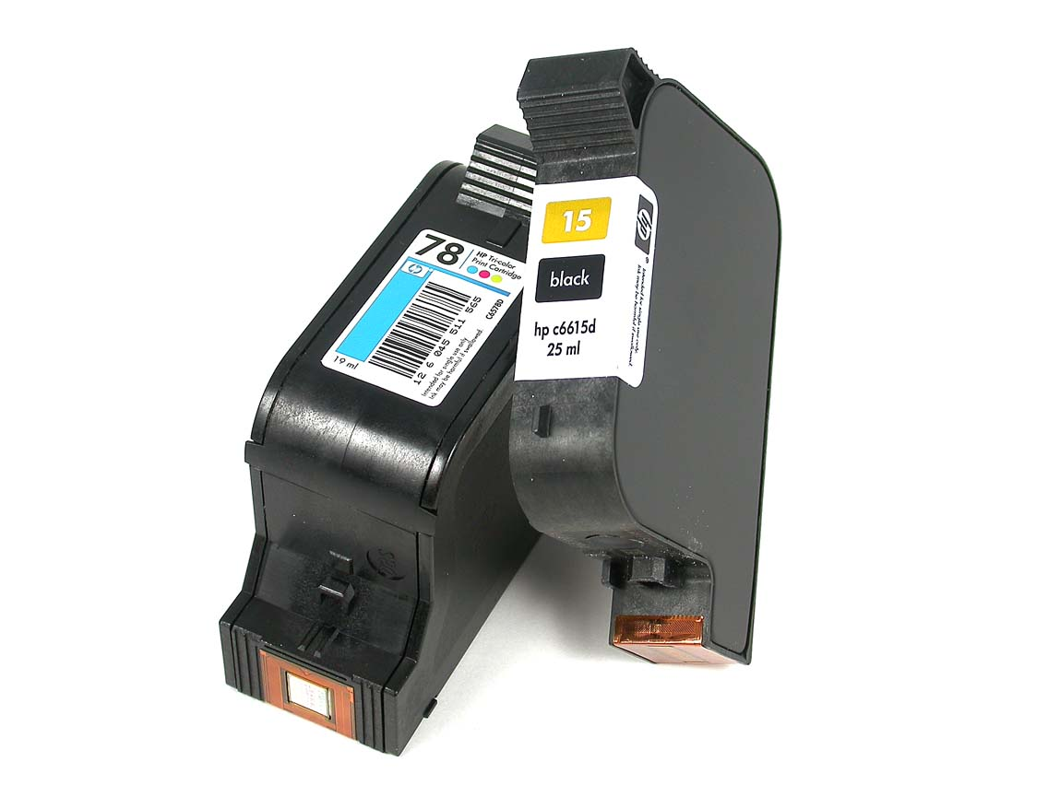
Inkjet printer cartridges

Slide 11
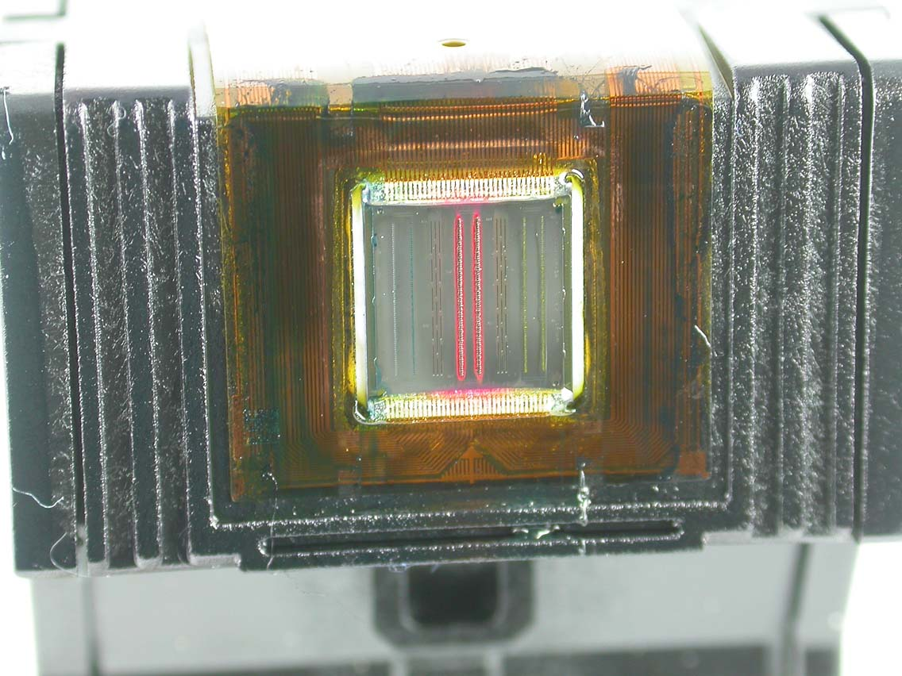
Inkjet cartridge print heads

Slide 12
Inkjet print quality
Affected by:
  DPI ( dots per inch) of the printer
  Quality of the paper
  Quality of the ink if printed page gets wet

Slide 13
Straight-through paper path

Slide 14
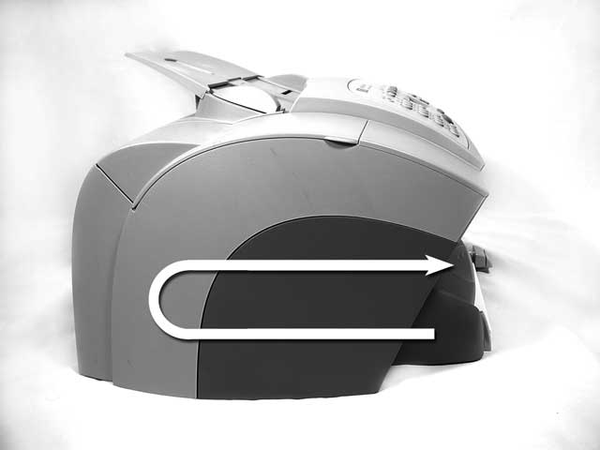
Curved paper path

Slide 15
Inkjet photo printers
Don’t hold up as long as traditional, chemically produced dark-room photos
Special paper required
Use regular paper = lower quality prints
Can print on non-paper items

Slide 16
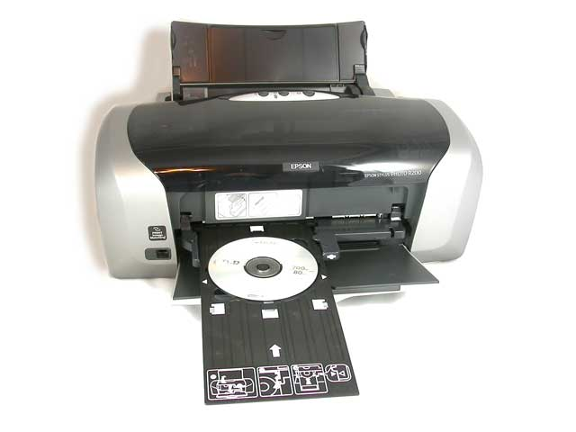
Printing on non-paper surface

Slide 17

Inkjet printer installation
Connect via USB
Windows autodetects and installs drivers
Can install additional software from manufacturer

Slide 18
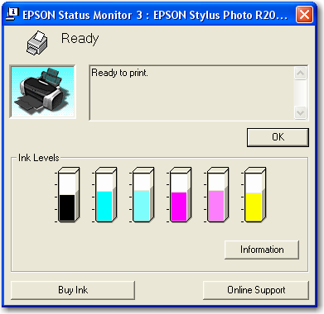
Ink level utility

Slide 19
Printer interfaces
USB
Parallel
SCSI
Serial

Slide 20
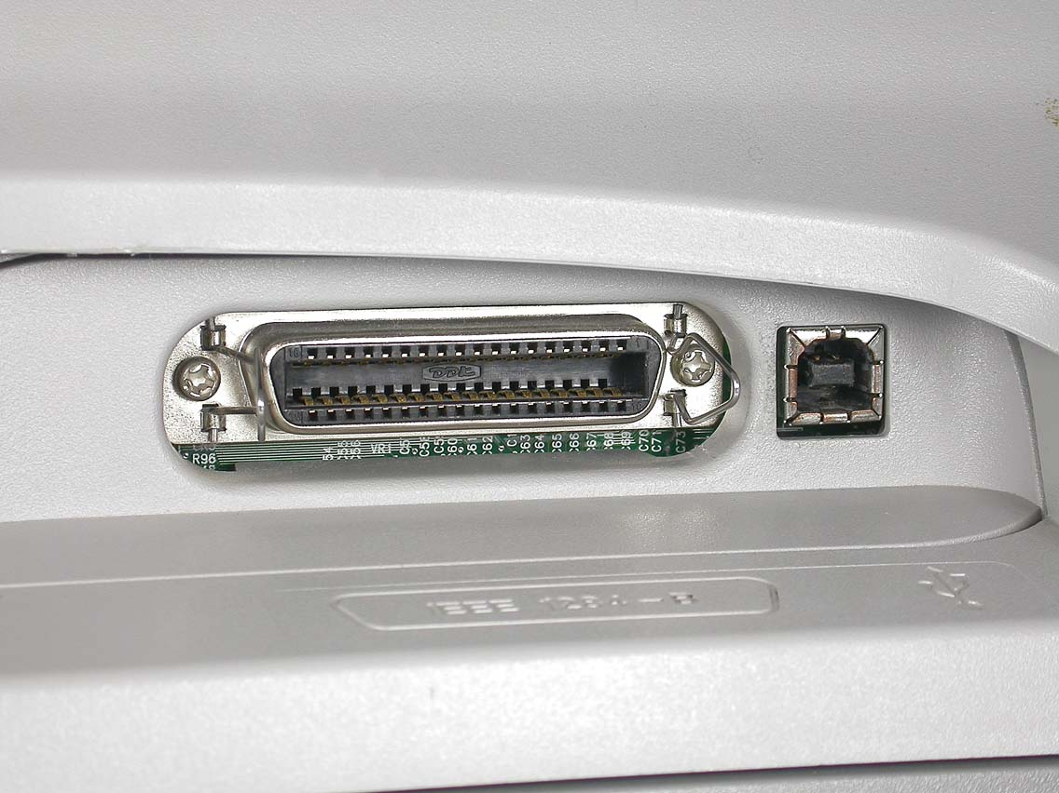
Inkjet communications interfaces
Parallel interface
USB interface

Slide 21
Configure connection type
SCSI — assign a unique device ID
Parallel — Specify the correct LPT port
Serial — Specify the correct COM port

Slide 22
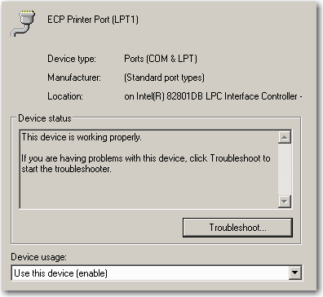
Parallel port in Device Manager

Slide 23
Installing an inkjet printer
Connect the printer to a computer using the correct interface
Plug it in
Power it up
Windows will likely recognize you’ve connected a new device and install drivers for it automatically
If drivers aren’t installed automatically, you can do it manually using the materials that shipped with the printer

Slide 24
Inkjet printer maintenance
Consumables
  Paper
  Ink levels
Color matching
Environment
Safety

Slide 25
Optimization
Paper trays/orientation (setup multiple trays for switching. Feature not always available on Inkjet printers)
Print spool settings (temp file where jobs are lined on your computer before sent to the actual printer).

Slide 26
Troubleshooting
Acquire information about the problem
Simplify by removing any non-critical components, shut down unnecessary running programs, and disconnect from the Internet or network.
Implement by identifying probable causes and implementing potential solutions one at a time.
Document the error symptoms, the components you removed from the computer, and the solutions you tried and whether they were successful.

Slide 27
Inkjet problems
Cost of consumables
Nothing prints
Poor print quality or stray lines
Paper jams

Slide 28
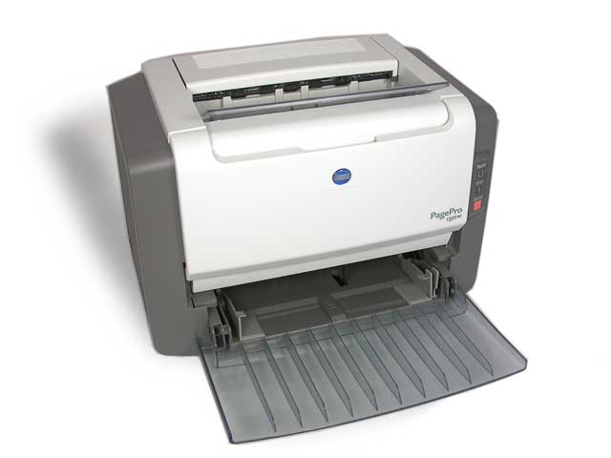
Laser printer

Slide 29
Producing Output on Laser Printer
Laser printers are standard level of quality by which printers are compared.
High quality documents in high volume printing
Mostly black and white output devices. But color printers are dropping in prices to be considered for home use depending on your volume of printing.
Electro-photographic : Combining electrostatic charges, toner and laser light, high quality images are produced. One page at a time.

Slide 30
Laser printer components
Toner cartridge
A hopper filled with toner. Toner is a fine powder composed of plastic, iron and carbon particles.
An EP drum covered with photosensitive coating that holds a static charge until exposed to light.
A blade to remove used toner from the drum.
A corona charging assembly, which applies a static to the drum after an image has been printed.

Slide 31
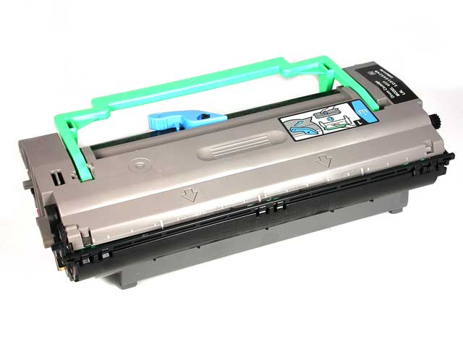
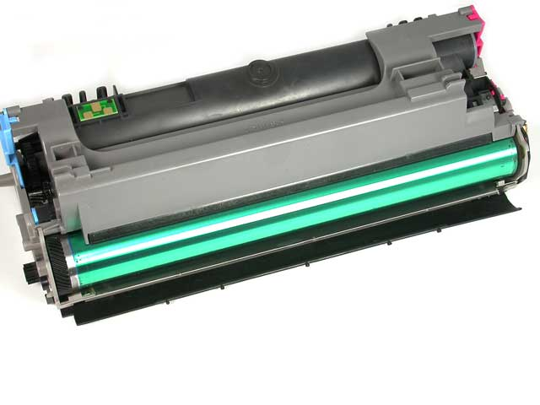
Toner cartridge

Slide 32
Laser printer components cont’d
Laser scanning assembly
Contains the following components:
Laser--- Shines on the drum and creates an electrostatic image of what’s printed.
Creates areas of negative charge on the positively charged drum.
Mirror--- Reflects the laser beam.
Lens --- Focuses the laser beam. Multiple lenses maybe used to focus the laser beam on the various areas of the drum: the areas being closer to or farther away from the mirror and laser beam.
Power supplies
A high voltage power supply (HVPS) converts 120 volt, 60 Hz AC current into high voltage electricity used by EP process. A DC supply (DCPS) is used to power components that don’t require high voltages.

Slide 33
Laser printer components cont’d
Paper control and transport assembly
Paper moved through the printer by a series of rollers. Some of the rollers simply guide the paper from one location to another and some rollers function to apply pressure to printed page to fuse the toner.
Transfer corona assembly
The HVPS applies a high voltage charge to the corona wire. The wire then charges the paper so that the toner from the drum can be transferred onto the paper as it passes under the drum. After the paper passes the drum, the static charge eliminator strip drains charges from the paper so that it doesn’t adhere to the toner cartridge and create a paper jam.
Fusing assembly
The fusing assembly is composed of rollers and a heating lamp. It applies heat and pressure to adhere the toner permanently to the page.
Electronic control package
Also known as the printer control circuitry or the main logic assembly. This component is responsible for communicating with the internal printer memory, the control panel and the computer from which the print job is being received.

Slide 34
Steps in the Laser printing process http://www.learnthat.com/certification/learn.asp?id=1142&index=0
Charging or conditioning
The primary corona wire applies a negative charge of approximately -600volts to the EP drum.
Writing or exposing
The laser beams reduces the negative charge to about -100 volts on the EP drum in the areas that become the image to be printed.
Developing: Areas of the drum that were written to by the laser attract toner.
Transferring: A positive charge of about +600volts is applied to the paper by transfer corona wire.
Fusing: Pressure and heat set the toner to the paper. A 350 deg F fusing roller melts the toner, and squeezing the paper through a set of rollers presses the toner into the paper.
Cleaning and erasing: A rubber blade clears the excess toner from the drum. Another corona wire removes the charges from the drum.

Slide 35
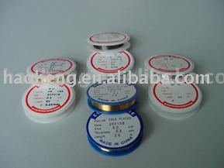
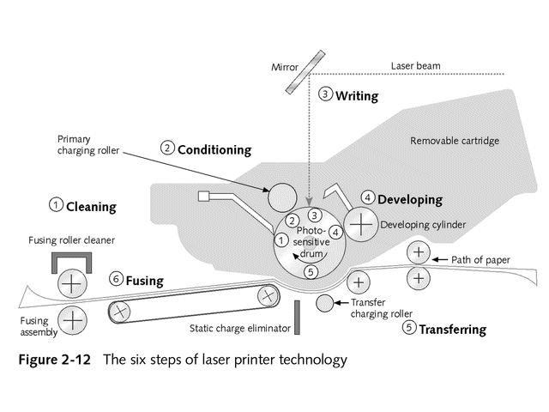
Laser print process (cont’d)
Corona wire packages

Slide 36
Unpacking
Toner is removed
  Gently roll toner cartridge side to side
Install drum
Remove Styrofoam from toner area
Remove packing tape
Install toner cartridge

Slide 37
Laser printer interfaces
Parallel
SCSI
USB
Serial
IEEE 1394/Firewire
Wired or wireless Ethernet network
Infrared ports

Slide 38
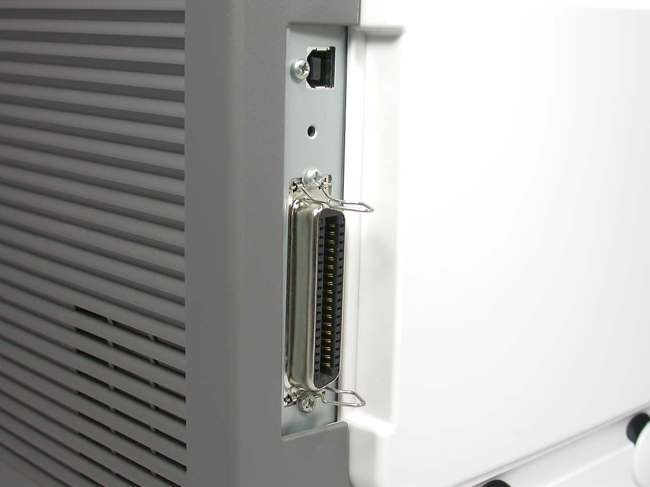
Communications interfaces

Slide 39
Installing a laser printer
Connect the printer to the network or a computer using the correct interface
Plug it in
Power it up
Windows will likely recognize you’ve connected a new device and install drivers for it automatically
If drivers aren’t installed automatically, you can do it manually using the materials that shipped with the printer

Slide 40
Printer configuration options
Orientation– Portrait or landscape
Collation– How the individual pages within a multi-page document are printed when you print more than one copy. Collated means entire copies of the document are printed together. Un-collated means that all the copies of page1 are printed before all the copies of page 2, and so forth.
Copies:-- Number of copies to print
Quality– Options for draft , normal or high quality on some printers. Others offer varying resolutions
Color:-- Specify full color or black and white print
Order:-- Some printers allow you to specify whether to print from last page to first or first to last on multi-page print jobs.
Switch print trays
Spool settings
Some configuration can be done through buttons on printer itself

Slide 41
Laser printer problems
Safety issues– Too much toner inhalation can be toxic, due to high voltage power supplies let printers cool off before working on them.
Paper jams: -- paper crumbles, no sensor signal sent, humidity levels above 50%, Damaged corona wire therefore no paper discharge and can stick to the drum.
All or nothing:-- Jobs on the print queue but nothing coming out from the printer (printer says ready) Check cables esp. those connected to the network.
-If paper comes out blank check the cartridge, a broken corona wire or a non working HVPS.
-If paper comes out all black, the drum isn’t being charged so toner sticks everywhere instead of just where the image should be created. This is usually due to a broken corona wire.
Partial prints and smudges:--Low toner,
-Indistinctive images are often a result of faulty corona wire or HVPS.
-Flakes off or smudges are due to fuser problems, replacing that is usually the solution.
Repeating marks and stray marks:-- due to dirty rollers or a scratched drums. A bad formatter board can also cause wavy output.
N.B. A formatter board interpret the computer output into commands that the printer can use to create your output
Garbage prints: due to bad formatter board, incorrect printer drives. Two common languages used to do computer to printer translation: PCL(Printer Control Language) and PostScript

Slide 42
Other printer types
Solid ink– use sticks of wax that are melted to create the ink for printing.
environmentally friendly, no ozone production. Ink sticks last aprox. 3000 pages compared to average 1500 for laser printers.
Dye sublimation:-- High quality printer. Solid dye contained on either a ribbon or a roll. The roll is consecutive pages of cyan, magenta, yellow and sometimes black. The dye diffusion thermal process is known as D2T.
Thermal Printers
  Thermal wax transfer
  Direct thermal
  Thermal autochrome

Slide 43
Plotters
Create line images
Use pens
Often available in large format for CAD drawings
Draws smooth lines and curves
Technology been applied to garment industry, sign industry etc

Slide 44
Additional printer types
Snapshot printers
Large format printers-- burners and large signs
Art printers--

Slide 45
Unit summary
Identified features of dot-matrix printers
Installed, used and troubleshot inkjet printers
Installed, used, and troubleshot laser printers
Identified other printer types

